Slide 1

Tasky
Badr El-Said
Adham Anas
Nour Khaled
Ali el-deen maher
Mohamed Mostafa
Youssef awed

Slide 2
“Plans are nothing; planning is everything.”
Dwight D. Eisenhower
Dwight D. Eisenhower

Slide 3
Introduction
In today's fast-paced world, individuals and teams struggle to stay organized and on top of their workloads, leading to missed deadlines, decreased productivity, and increased stress.
Using Tasky, you can regain control of your time and achieve your goals with ease.
Tasky provides a user-friendly platform for organizing tasks, setting priorities, tracking progress, and collaborating with others.

Slide 4

objectives
An Application that help users:
Manage their time efficiently .
Organize their tasks and categorize them into projects.
Set due dates for tasks with Notifications and reminders for upcoming due dates.
Filter tasks by priority, or due date.
Track their progress in completing their tasks.

Slide 5
Features
Tasky includes four main pages/Tabs:
The Task tab
Study techniques tab
Tasks progress tab
The Calendar

Slide 6
Task tab
The main page for the app

Slide 7
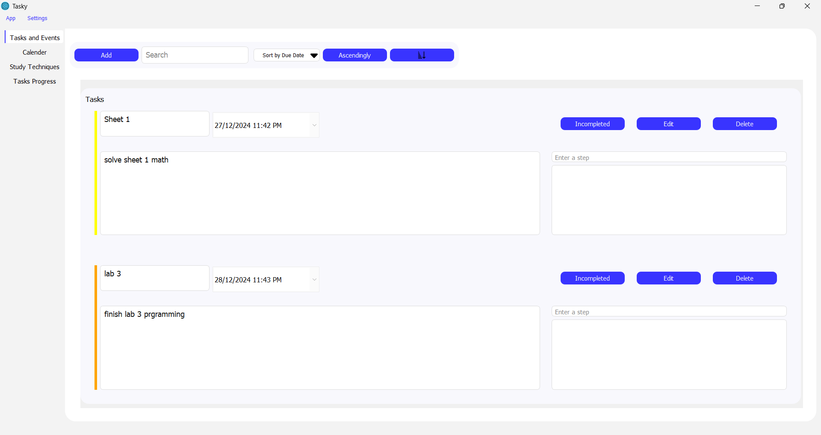
Task Tab
In the task tab we can create our tasks or events , search , sort , edit or delete existing tasks and mark tasks as completed if we finished them

Slide 8
Task Tab
By clicking on “Add” button , we can create our customized tasks

Slide 9
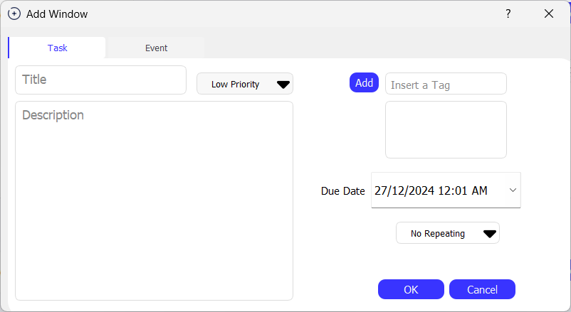
Task Tab
In the “Add Window” there are multiple fields to customize the task

Slide 10
Task Tab
Set the Task Title and Description

Slide 11
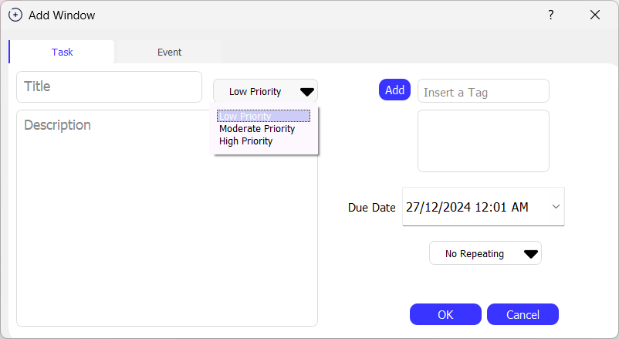
Task Tab
2. Set the task priority based on its importance for you

Slide 12
Task Tab
3. Choose a tag for your task to categorize it (optional)

Slide 13
Task Tab
4. Set the deadline/Due Date for the task

Slide 14
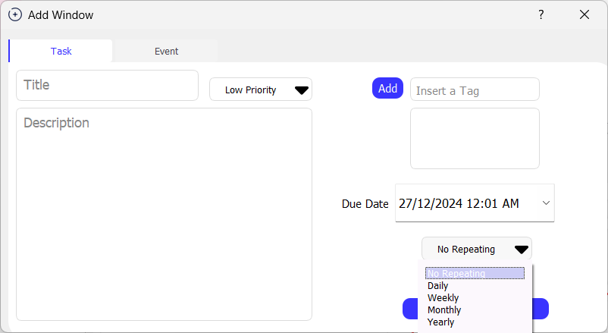
Task Tab
5. Choose the repeating manner of the task (None, daily, weekly, monthly, yearly)

Slide 15
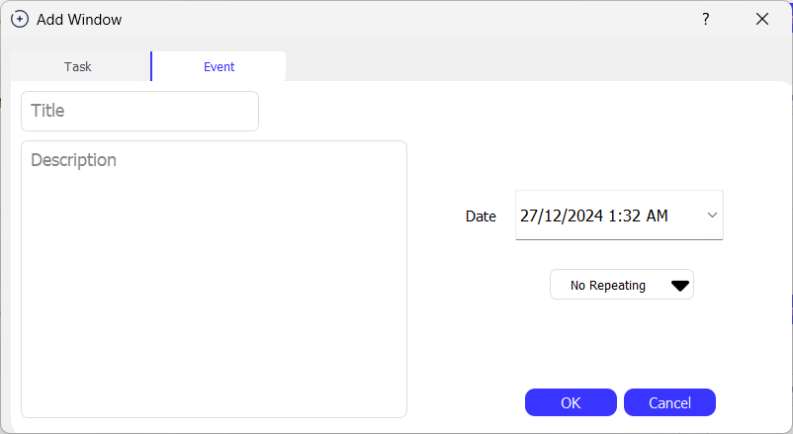
Task Tab
We can add also an event the same way as the task

Slide 16
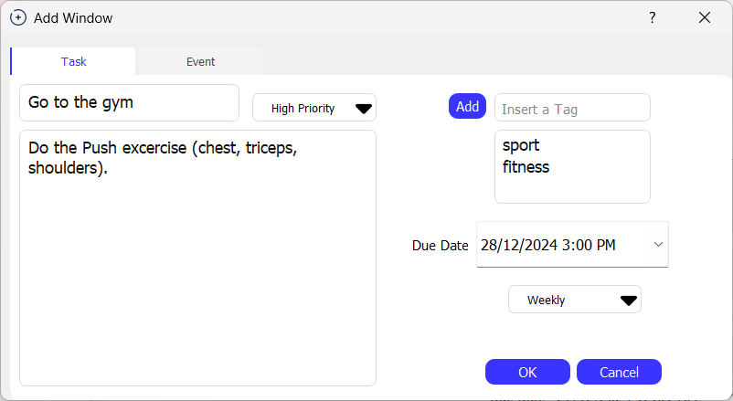
Task Tab
6. Example of creating a task

Slide 17
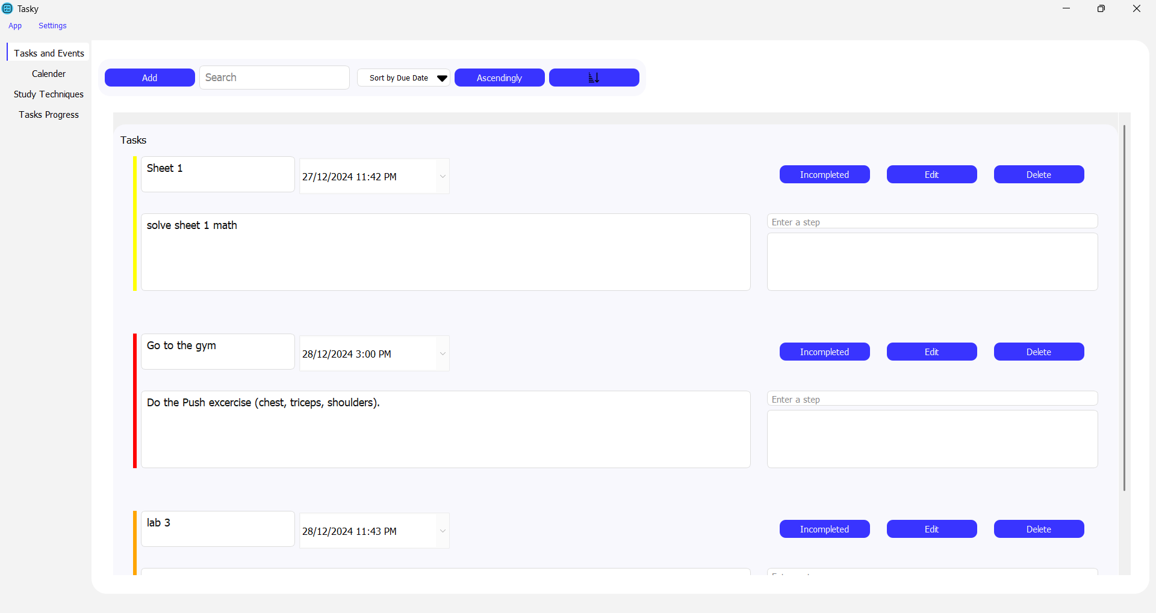
Task Tab
6. Example of creating a task

Slide 18
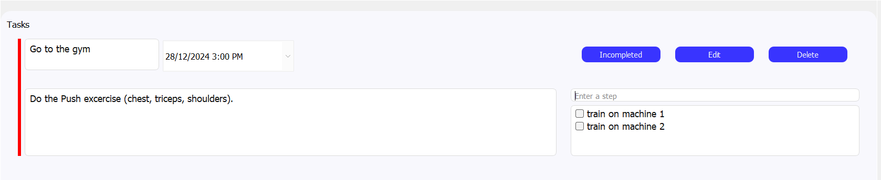
Task Tab
We can enter any number of subtasks for a single tasks

Slide 19
Task Tab
By clicking on “Edit” button , we can edit the current task

Slide 20
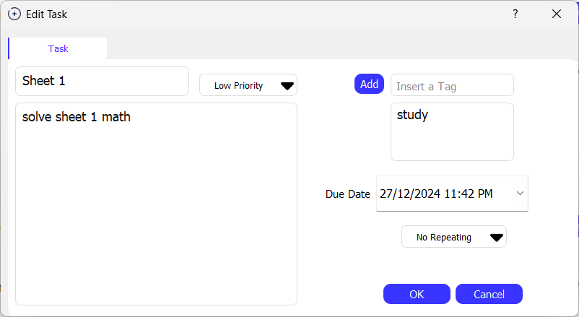
Task Tab
In the Edit Window , we can edit any field of the previous fields

Slide 21
Task Tab
By clicking on “delete” button, we can remove the task

Slide 22
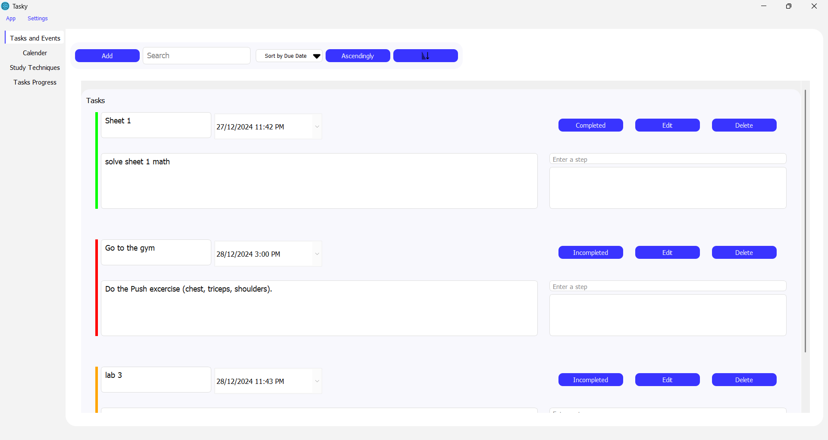
Task Tab
By clicking on “Incompleted” button, the task marked as completed and the task bar changes to green

Slide 23
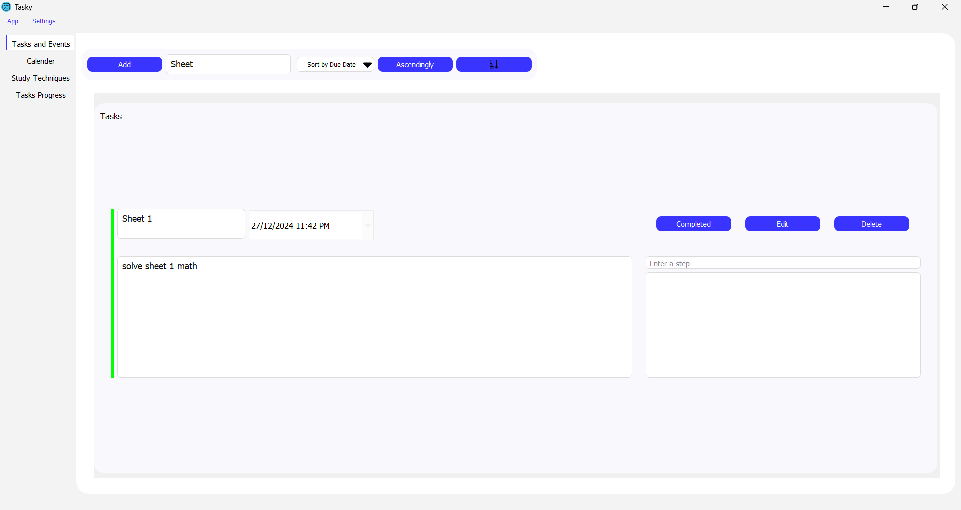
Task Tab
We can search for the task based on its title

Slide 24
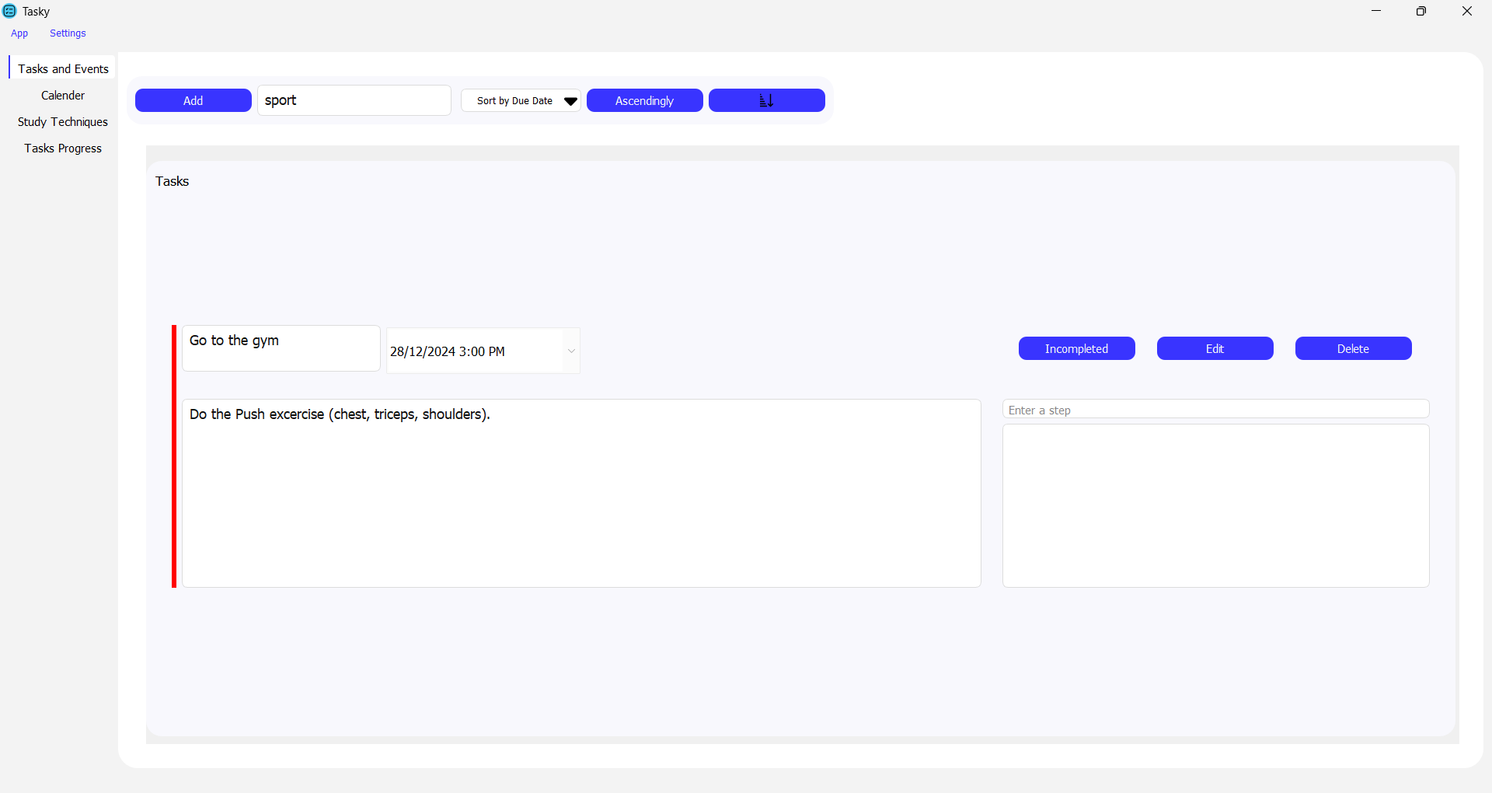
Task Tab
We can also search for the task based on its tag

Slide 25
Task Tab
We can sort the existing tasks based on the “Due Date” in both ascending and descending way

Slide 26
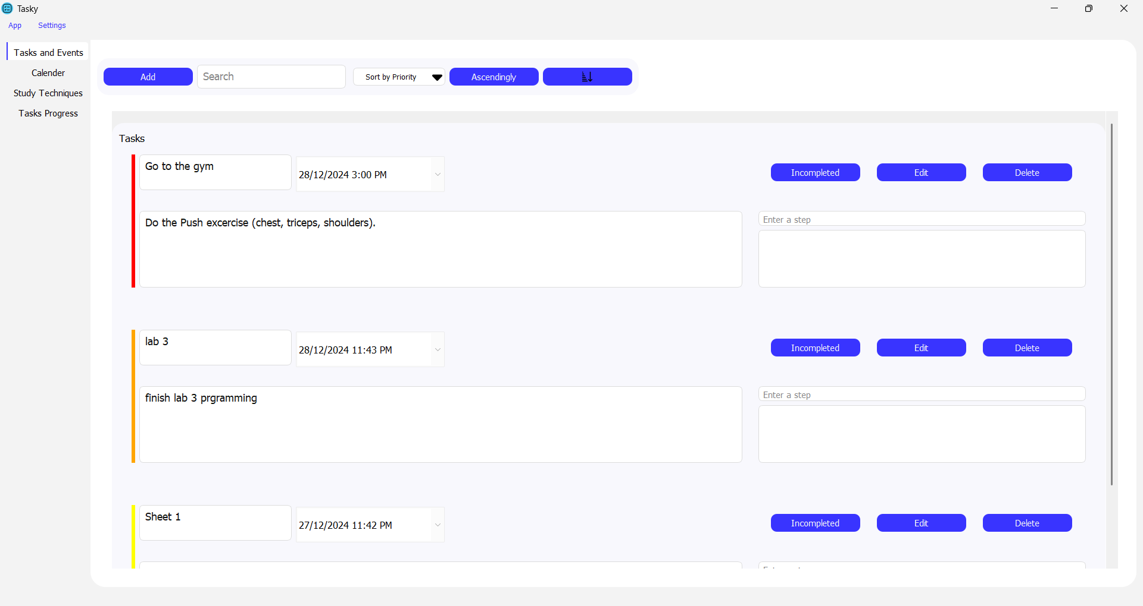
Task Tab
We can sort the existing tasks based on the “priority” in both ascending and descending way the colors indicates the priority (red for high priority, orange for moderate, yellow for low)

Slide 27
app settings
Customize your preferences and app settings

Slide 28
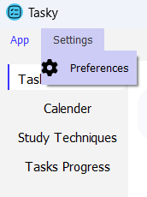
App Settings
App settings can be accessed from the top left corner where you can customize the app and choose your preferences

Slide 29
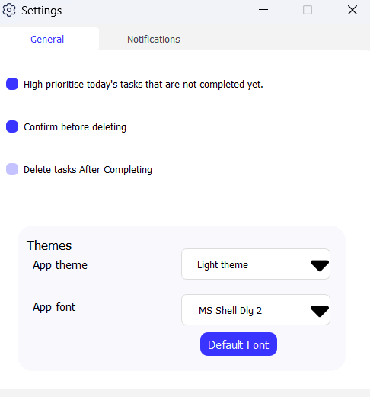
App Settings
You can make it automatically priorates your tasks.
You can keep or remove the confirm message when you delete tasks.
You can make it automatically deletes your completed tasks.

Slide 30
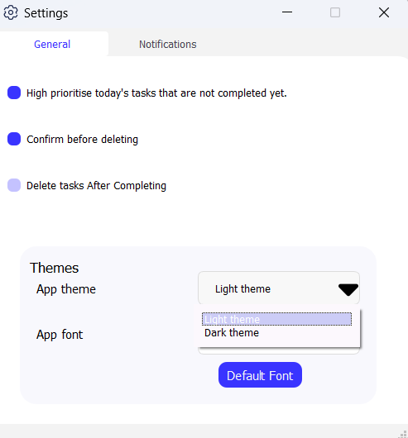
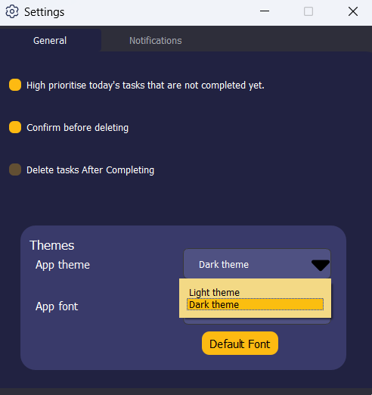
App Settings
Change the app theme from light to dark to make it more
comfortable
for your eyes.

Slide 31
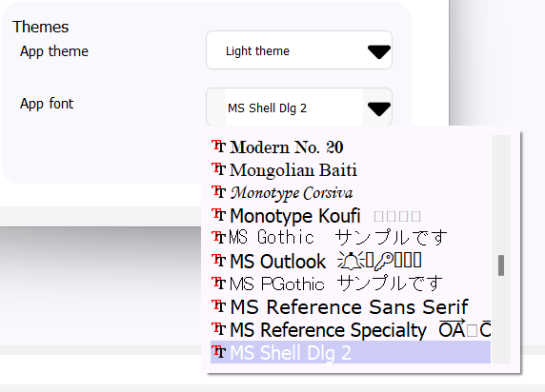
App Settings
Change the app font from many different fonts to make the app look best for you.

Slide 32
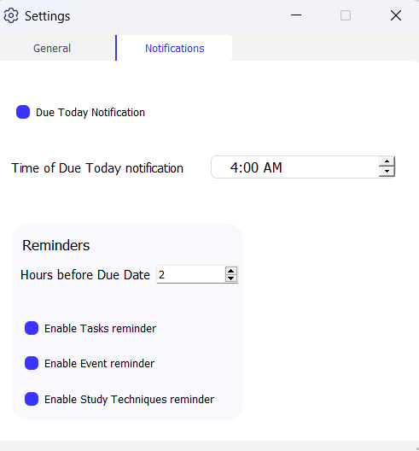
App Settings
You can also set a notification for the due today tasks and control the exact time you want the notification.

Slide 33
App Settings
You can set a reminder to remind you of the in completed tasks by a certain time before the due date.
You can enable it for the Tasks, Events and the Study Techniques too.

Slide 34
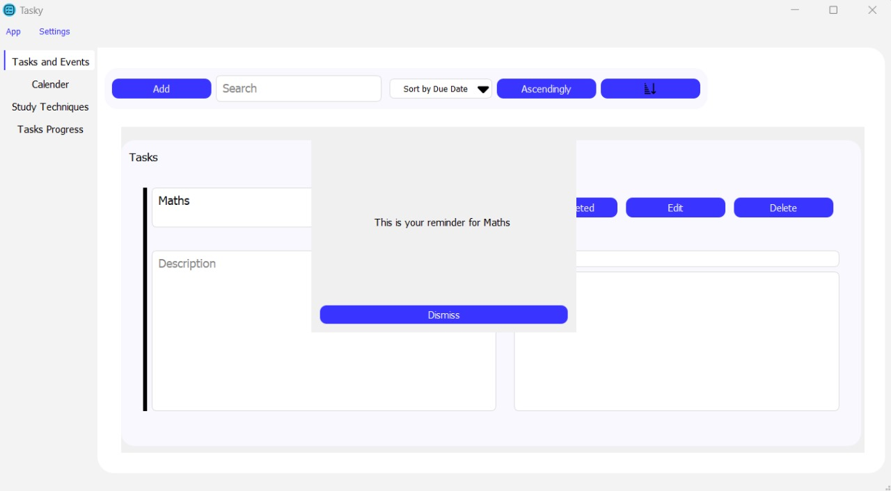
App Settings
The reminder set by you appears as a window and a reminder sound plays till “Dismiss” is clicked

Slide 35
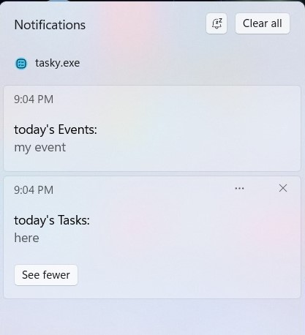
App Settings
The notifications appear at the time you set in the notification's settings

Slide 36
Calendar tab
Visualize tasks in the month

Slide 37
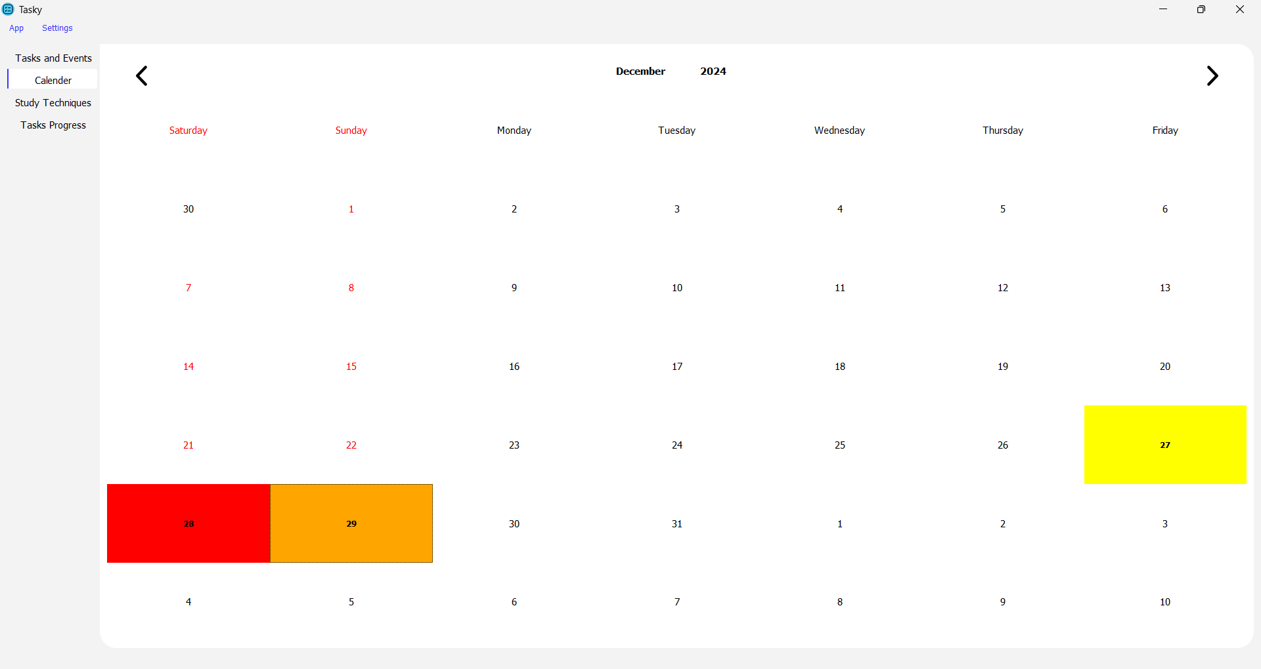
Calendar Tab
In the calendar tab you can observe tasks/events in the calendar form

Slide 38
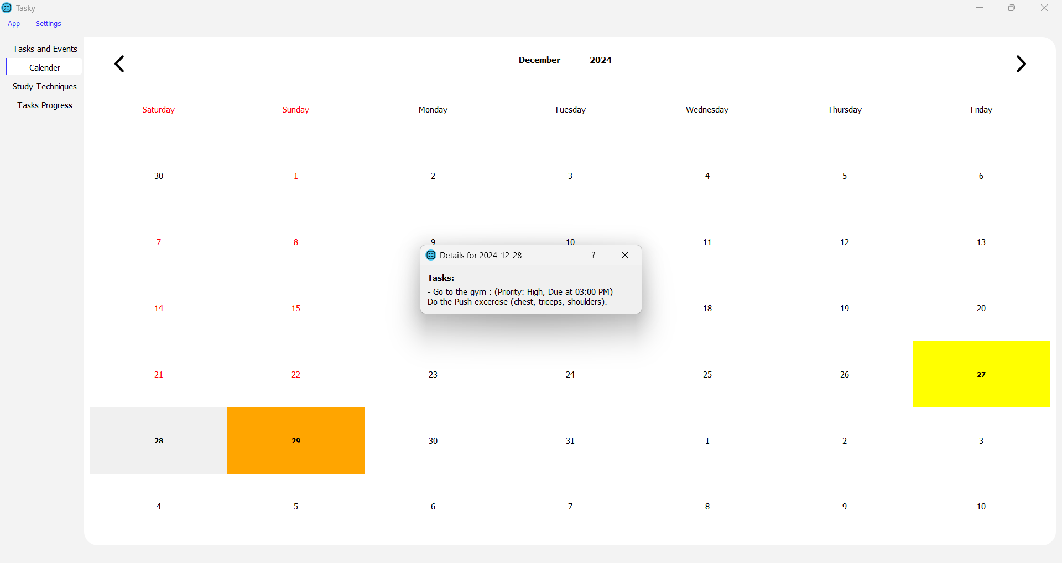
Calendar Tab
By clicking on any day , we can display that day tasks

Slide 39
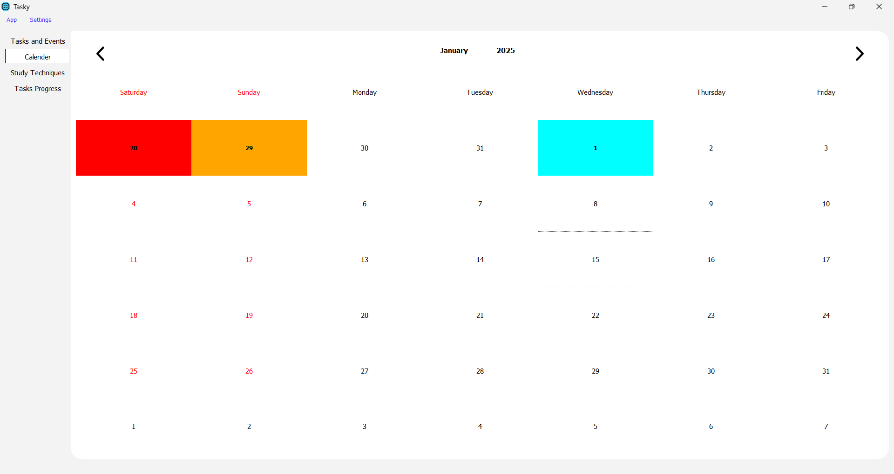
Calendar Tab
Events are added directly and shown in the calendar tab for more simplicity with the light blue color

Slide 40
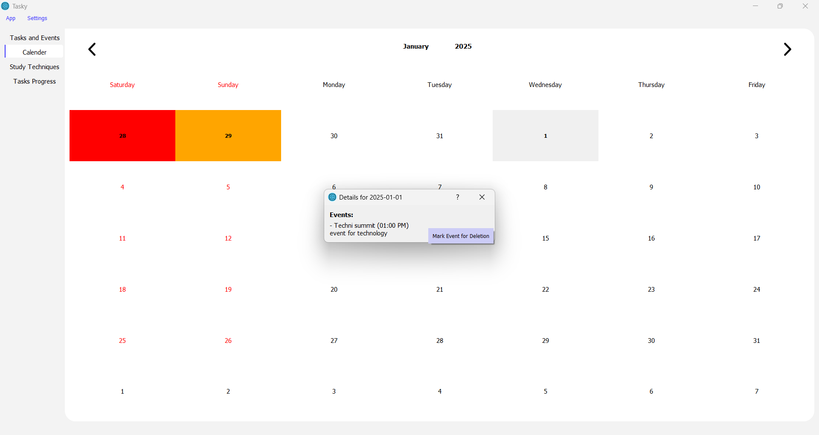
Calendar Tab
We can delete events directly from the calendar

Slide 41
study techniques tab
Boost your study productivity

Slide 42
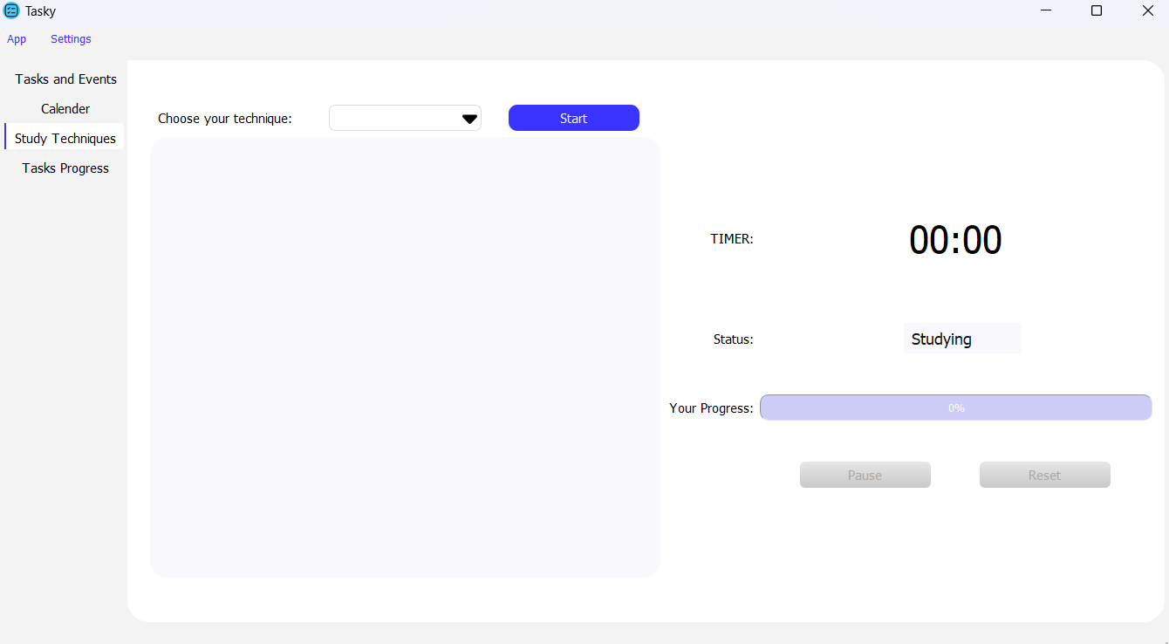
Study Tab
This tab provides a selection of proven study technique tailored to enhance focus and efficiency

Slide 43
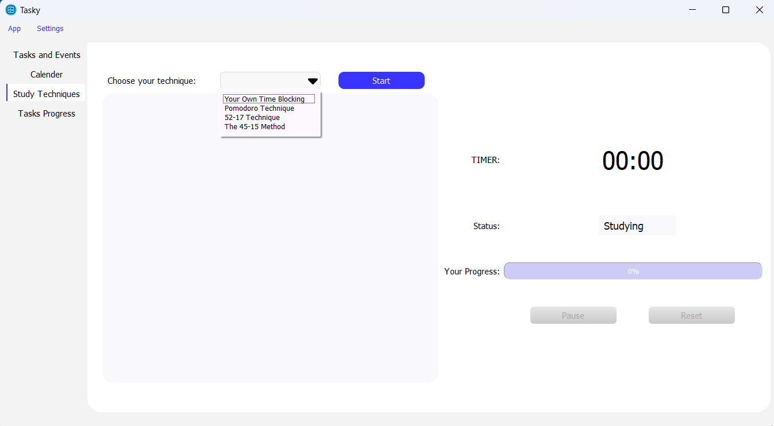
Study Tab
Choose the study technique or create your own

Slide 44
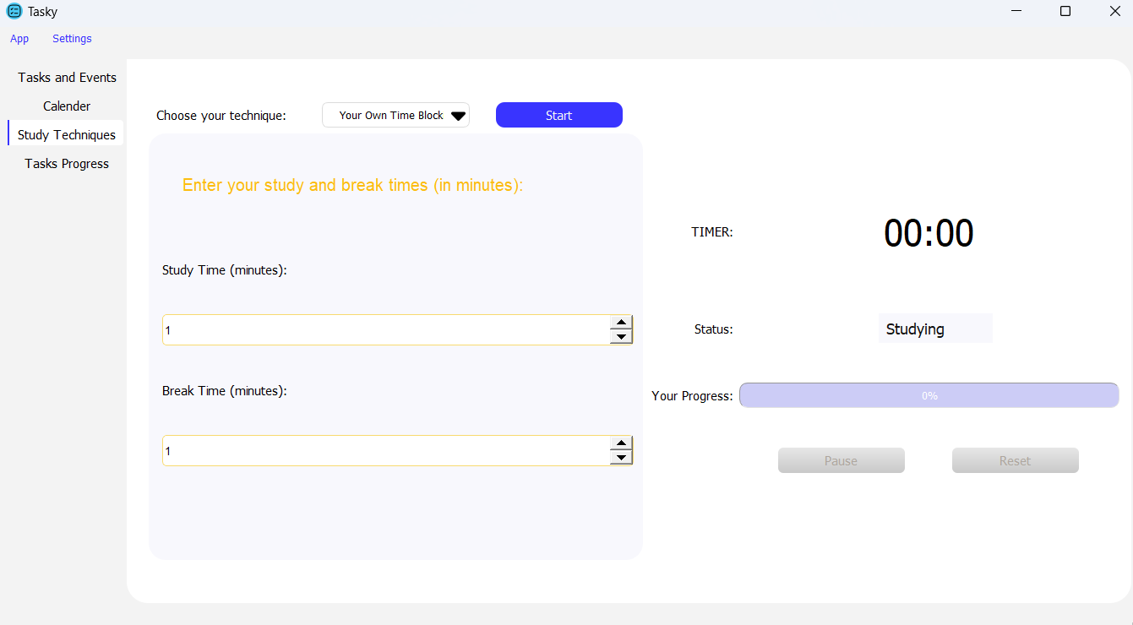
Study Tab
You can create your own time blocking (Study, break) that suits you the best

Slide 45
Study Tab
By clicking “start” the timer will start and “Pause” and “reset” will be enabled

Slide 46
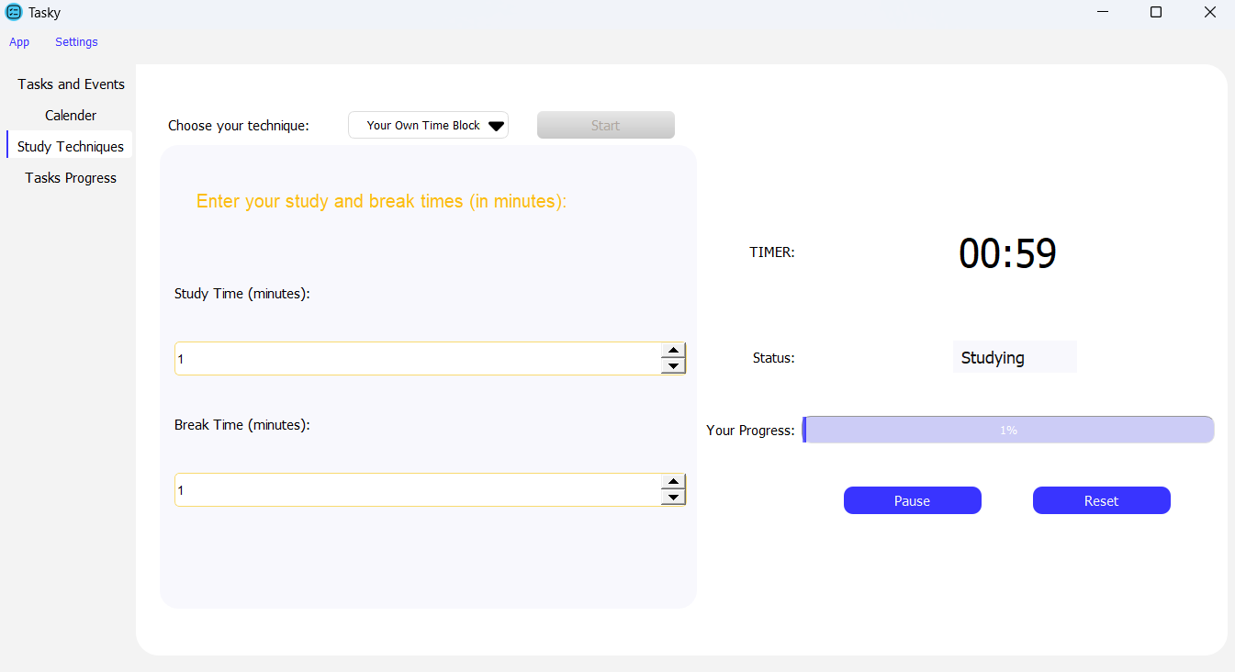
Study Tab
Click “reset” to restart the same or new technique and “Pause” to stop the timer

Slide 47
Study Tab
The “TIMER” will display how many minutes left , “Status” will display the status (Studying or break) and “Your progress” to help you visualize how many you achieved

Slide 48
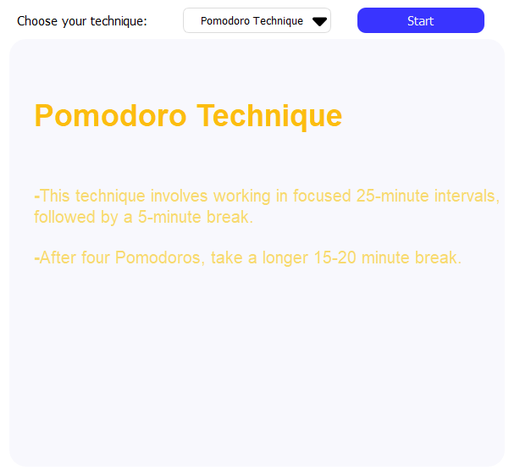
Study Tab
Every technique you choose will display a brief description for the technique (study time in minutes and break time in minutes) to help you choose the best technique.

Slide 49
task progress tab
ANALYZE WEEKLY AND MONTHLY TASKS PERFORMANCE WITH INSIGHTFUL GRAPHS

Slide 50
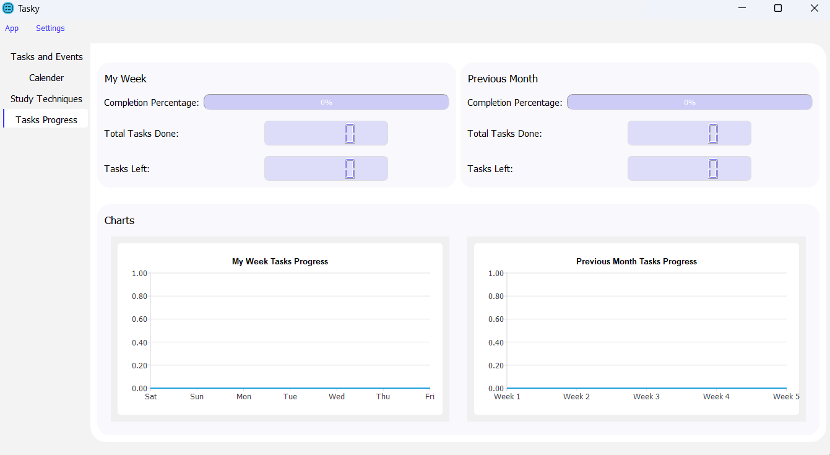
Task Progress Tab
Keep track of your progress in this week and Previous month

Slide 51
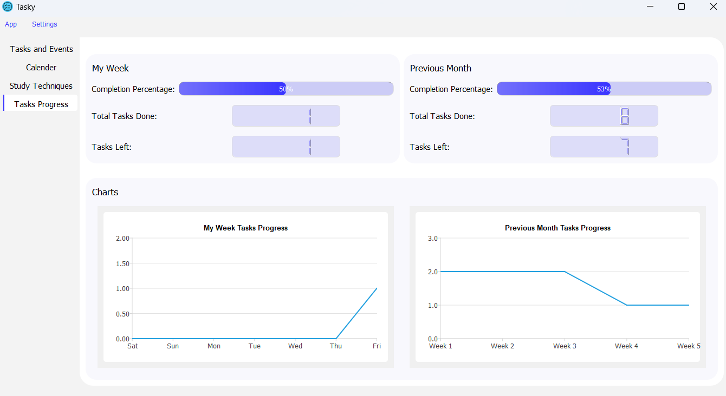
Task Progress Tab
It contains progress bar and summary of the tasks done and tasks left in this week to keep track of your work

Slide 52
Task Progress Tab
It contains charts to help you visualize your work on this week and previous month

Slide 53

ANY QUESTIONS

Slide 54
THANK YOU

